Slide 1
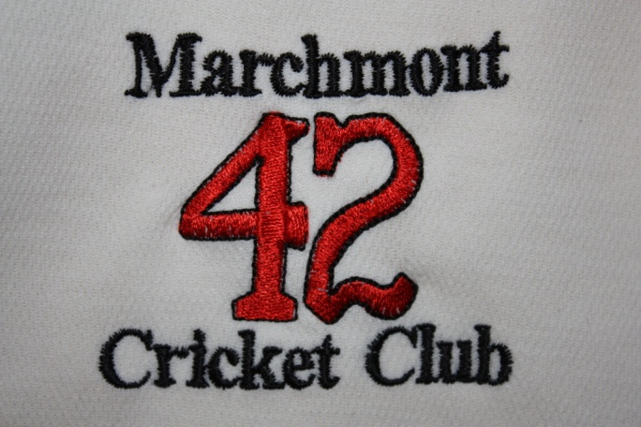
Marchmont CC MPL Auction
Friday 13th May

Slide 2
Thanks to Jude & the Golf Tavern for helping with the auction.

Slide 3
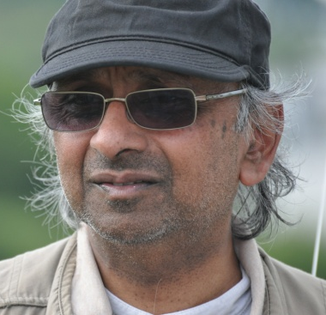
Celebrity Managers
MPL Player Auction
??
??
??
??
Bashir Wadee
Shelagh Green
& Sara Loeffen
Corne Van Jaarsveld
Mahendra Chetty

Slide 4
The 24 Players
MPL Player Auction
Jay Paul Chetty
Navin Chetty
Will Collier
Nirmal Gandhi
Euan Granger
Neil Granger
Liam Healy
Praveen Hiremath
Jonathan Leburn
Matt Loeffen
Stuart Macgregor
Pete Maksimczyk

Slide 5
The 24 Players
MPL Player Auction
Simon Marr
Savan Panchal
Harith Ramachandra
Mani Ramachandran
Mike Reed
Aaron Sardesai
Davi Sardesai
Nayan Sardesai
Abbas Sheikh
Farhan Sheikh
Kiran Singh
Ramesh Viswanathan

Slide 6
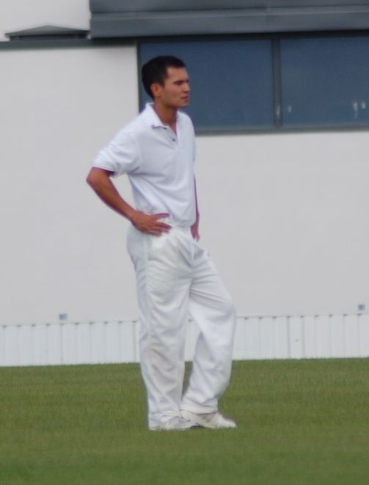
Jay Paul Chetty
MPL Player Auction
AKA:
20|20 Batting: 7 @ 2.33
20|20 Bowling: 1 @ 32.00
MCC Career 4s & 6s: 17 & 1
Known for: Having 5 different mobiles and not being contactable on any!

Slide 7
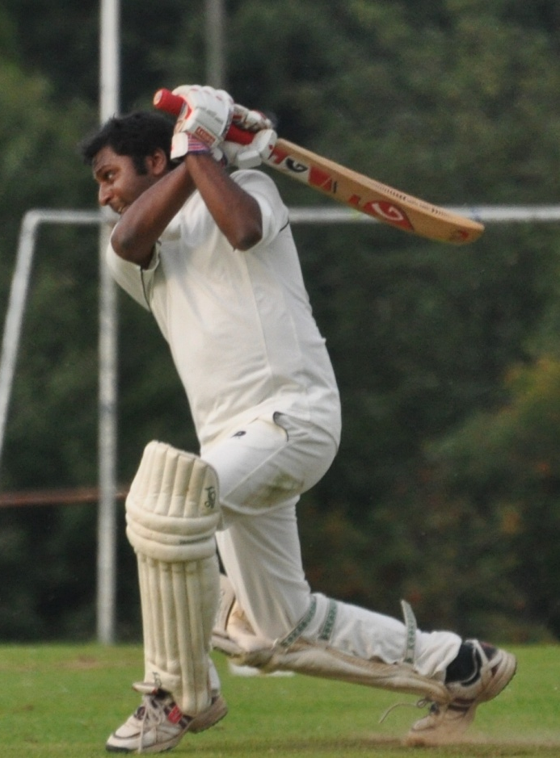
Navin Chetty
MPL Player Auction
AKA: Chettley, Sleepy
20|20 Batting: 302@ 18.88
20|20 Bowling: 4 @ 14.00
MCC Career 4s & 6s: 290 & 3
Favourite Shot: Calypso Flail

Slide 8
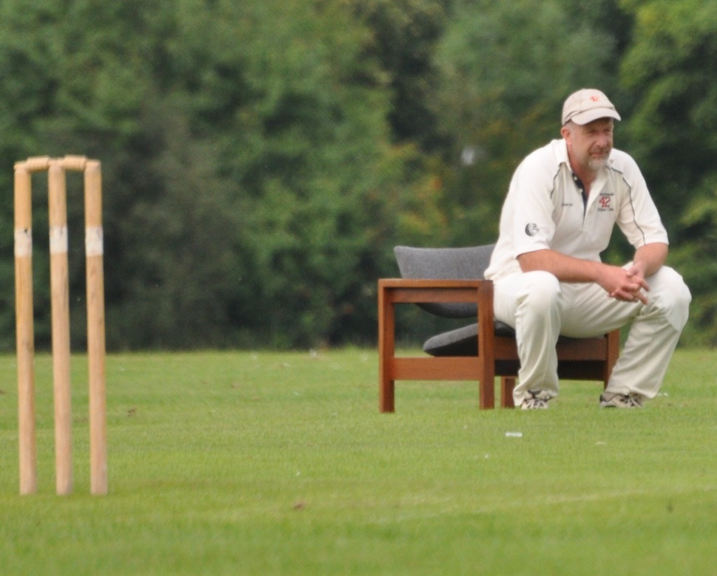
Will Collier
MPL Player Auction
AKA: The Snail
20|20 Batting: 1410 @ 25.64
20|20 Bowling: 56 @ 17.18
MCC Career 4s & 6s: 502 & 115
Most Likely To: Be winning at poker

Slide 9
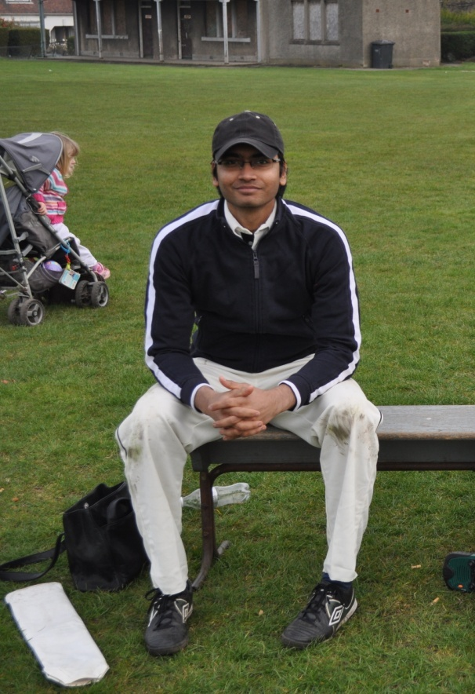
Nirmal Gandhi
MPL Player Auction
AKA: Ray
20|20 Batting: 177 @ 29.50
20|20 Bowling: 10 @ 13.30
MCC Career 4s & 6s: 38 & 4

Slide 10
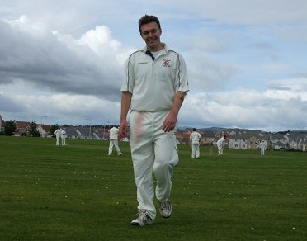
Euan Granger
MPL Player Auction
AKA: Microchip
20|20 Batting: 8 @ 2.00
20|20 Bowling: 23 @ 16.96
MCC Career 4s & 6s: 6 & 1
MCC Highlight: Hitting his first and only 6 off…Bashir

Slide 11
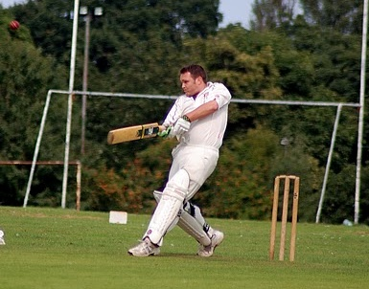
Neil Granger
MPL Player Auction
AKA: Chippy, Website
20|20 Batting: 453 @ 15.62
20|20 Bowling: 103 @ 16.14
MCC Career 4s & 6s: 102 & 5
Most Likely to be: Doing statistics

Slide 12
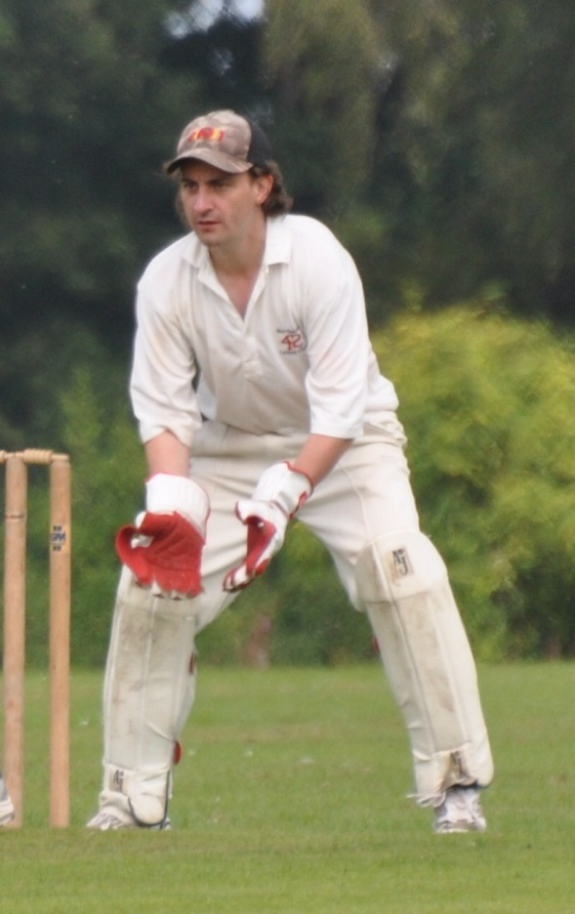
Liam Healy
MPL Player Auction
AKA: Merlin
20|20 Batting: 33 @ 4.71
20|20 Bowling: 1 @ 21.00
MCC Career 4s & 6s: 28 & 0

Slide 13
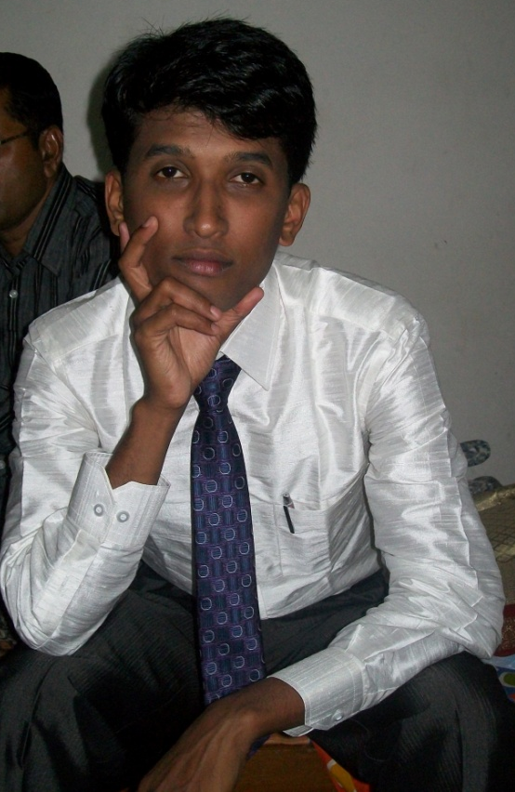
Praveen Hiremath
MPL Player Auction
AKA:
20|20 Batting: N/A
20|20 Bowling: 1 @ 30.00
MCC Career 4s & 6s: N/A

Slide 14
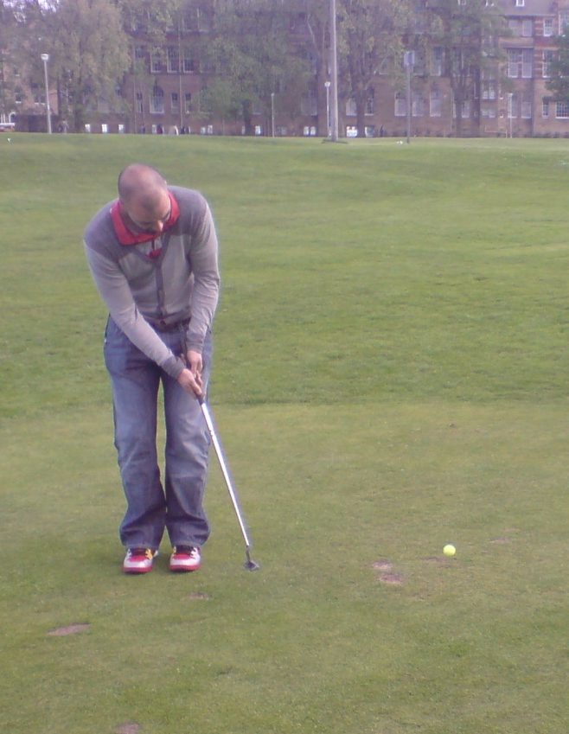
Jonathan Leburn
MPL Player Auction
AKA: Joppy
20|20 Batting: 306 @ 20.40
20|20 Bowling: 3 @ 12.00
MCC Career 4s & 6s: 58 & 6

Slide 15
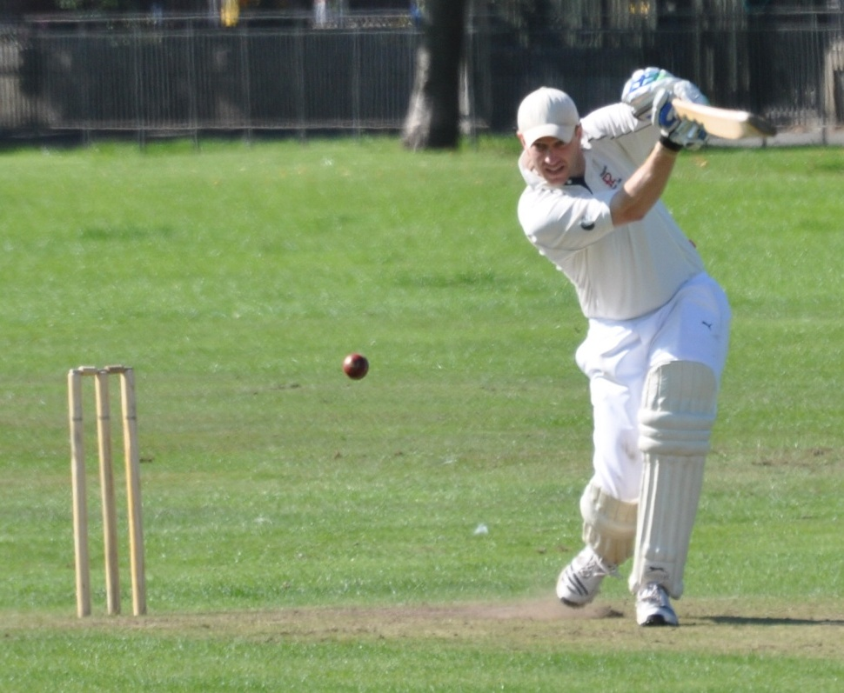
Matt Loeffen
MPL Player Auction
AKA:
20|20 Batting: 620 @ 44.29
20|20 Bowling: 6 @ 18.67
MCC Career 4s & 6s: 263 & 36
Known for: Destroying club records

Slide 16
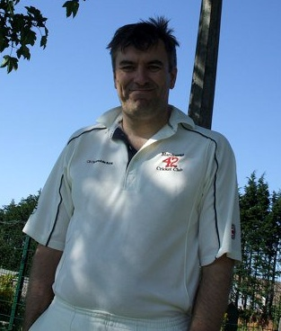
Stuart Macgregor
MPL Player Auction
AKA:
20|20 Batting: 974 @ 27.83
20|20 Bowling: 1 @ 20.00
MCC Career 4s & 6s: 405 & 33
Known for: The bat with the 10p middle

Slide 17
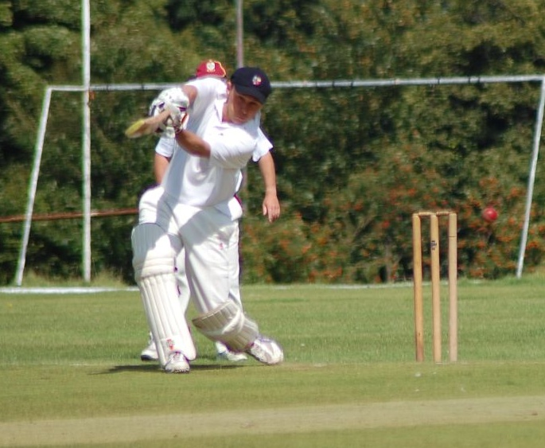
Pete Maksimczyk
MPL Player Auction
AKA: Peaches
20|20 Batting: 240 @ 15.00
20|20 Bowling: 35 @ 17.97
MCC Career 4s & 6s: 46 & 6
Most Likely to: Be secretly loving these statistics

Slide 18
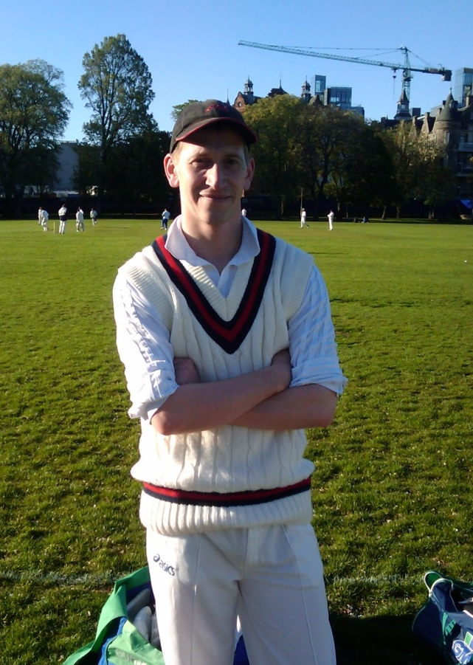
Simon Marr
MPL Player Auction
AKA:
20|20 Batting: 50 @ 7.14
20|20 Bowling: 21 @ 25.43
MCC Career 4s & 6s: 4 & 0

Slide 19
Savan Panchal
MPL Player Auction
AKA:
20|20 Batting: 12 @ 12.00
20|20 Bowling: 1 @ 14.00
MCC Career 4s & 6s: 6 & 0

Slide 20
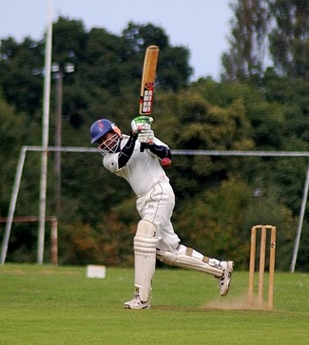
Harith Ramachandra
MPL Player Auction
AKA:
20|20 Batting: 19 @ N/A
20|20 Bowling: 0 @ N/A
MCC Career 4s & 6s: 61 & 3

Slide 21
Mani Ramachandran
MPL Player Auction
AKA:
20|20 Batting: 0 @ 0.00
20|20 Bowling: 0 @ N/A
MCC Career 4s & 6s: 5 & 0

Slide 22
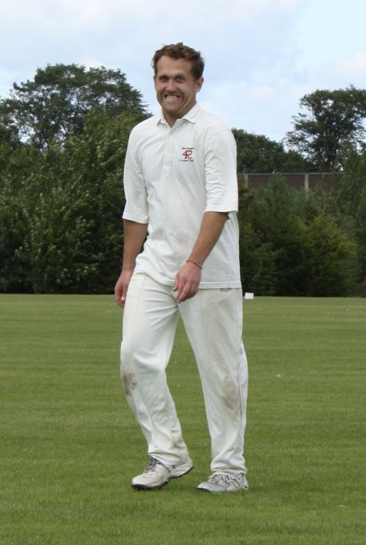
Mike Reed
MPL Player Auction
AKA:
20|20 Batting: 404 @ 12.62
20|20 Bowling: 12 @ 21.33
MCC Career 4s & 6s: 120 & 7
Favourite Shot: Gulley Cut

Slide 23
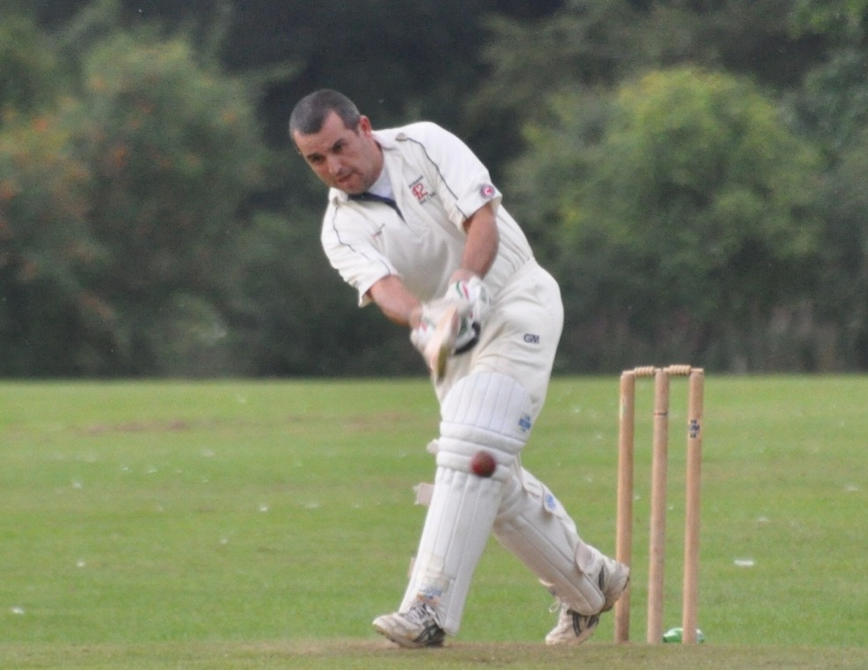
Aaron Sardesai
MPL Player Auction
AKA: Aero
20|20 Batting: 2221 @ 29.22
20|20 Bowling: 14 @ 11.43
MCC Career 4s & 6s: 834 & 92

Slide 24
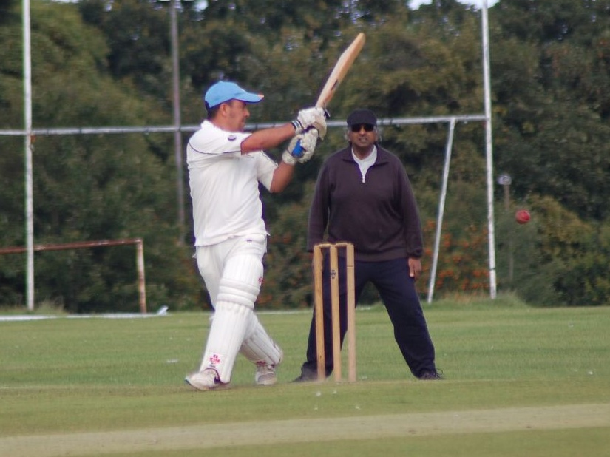
Davi Sardesai
MPL Player Auction
AKA: Dagles, Charlie Parker
20|20 Batting: 22 @ 7.33
20|20 Bowling: 11 @ 10.91
MCC Career 4s & 6s: 58 & 0

Slide 25
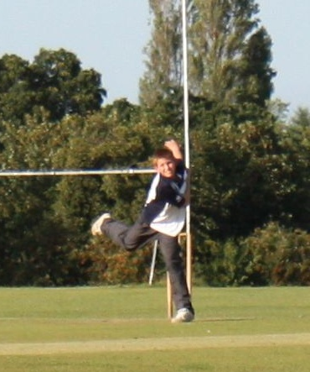
Nayan Sardesai
MPL Player Auction
AKA:
20|20 Batting: 0 @ 0.00
20|20 Bowling: 1 @ 3.00
MCC Career 4s & 6s: 0 & 0
MCC Highlight: His first wicket against Widows

Slide 26
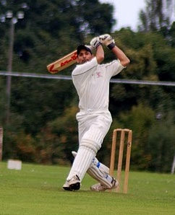
Farhan Sheikh
MPL Player Auction
AKA: Fran, Fish
20|20 Batting: 53 @ 7.57
20|20 Bowling: 4 @ 11.00
MCC Career 4s & 6s: 31 & 3
Known for: Smashing windows

Slide 27
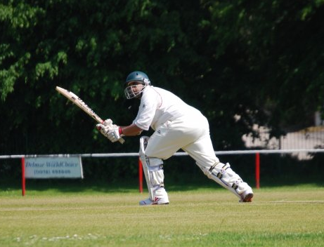
Abbas Sheikh
MPL Player Auction
AKA: Sinista
20|20 Batting: 24 @ N/A
20|20 Bowling: 2 @ 13.50
MCC Career 4s & 6s: 1 & 0

Slide 28
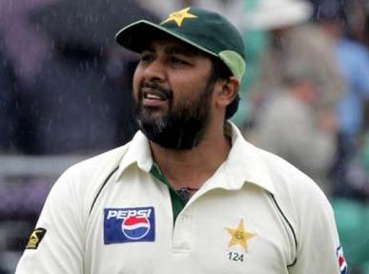
Kiran Singh
MPL Player Auction
AKA:
20|20 Batting: N/A
20|20 Bowling: N/A
MCC Career 4s & 6s: 0 & 0
Known for: Being Inzamam Ul-Haq…apparently!

Slide 29
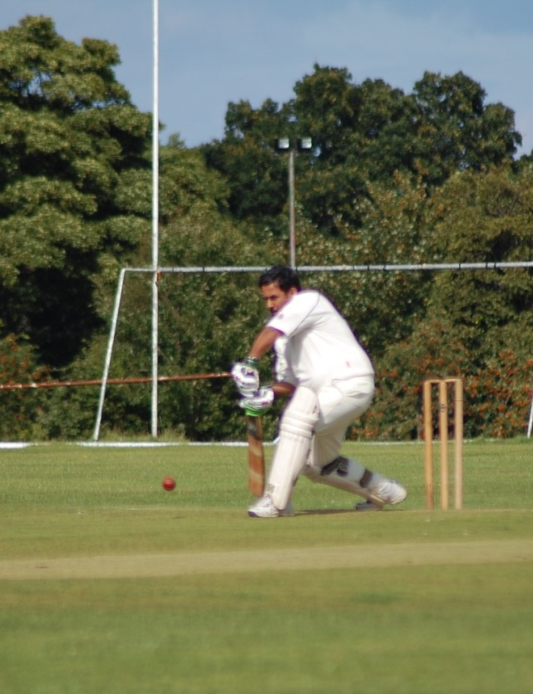
Ramesh Viswanathan
MPL Player Auction
AKA: Rambo
20|20 Batting: 32 @ 8.00
20|20 Bowling: 6 @ 25.33
MCC Career 4s & 6s: 20 & 3

